Slide 1
Lead & Tender Management System (LTMS)
PRESENTED BY
Your Name
Your Organization
April 05, 2026
Made with SlideMaker.app

Slide 2

Current Progress: Completed Requirements
Multi-Module Tracking
Lead Segregation
Fully developed modules for Budgetary Quotations, Lead Management, and Orders Received, enhancing operational efficiency and data accuracy across the system.
Implemented tracking for five distinct lead sub-types: Submitted, Domestic, Export, CRM Leads, and Lost Leads, allowing for targeted analysis and strategy.
Detailed Data Capture
22-field tracking for leads includes Financials, Tender Details, and Outcomes, ensuring comprehensive data collection for informed decision-making.
Made with SlideMaker.app

Slide 3
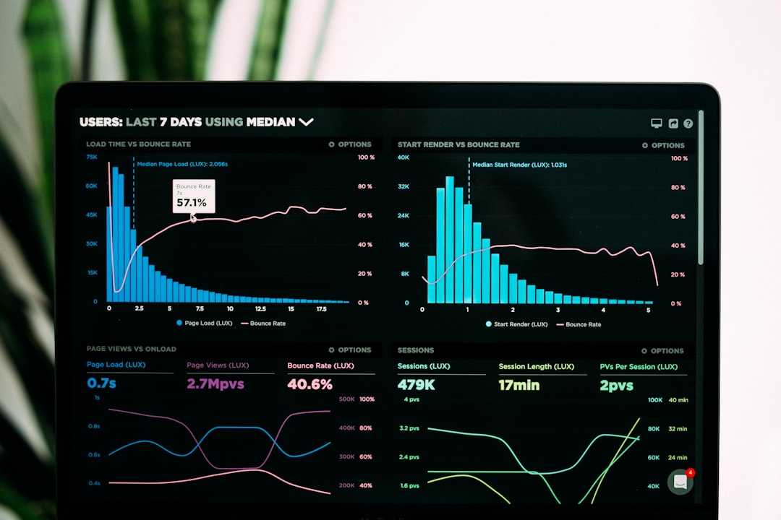
Current Progress: Dashboard & Analytics
Interactive Performance Metrics
High-Level Trends Visualization
Our dashboard features 10 interactive charts and 6 real-time KPI cards, providing insights into Win Rate %, Total Orders, and Order Value in Crores.
Visual representations of high-level trends and lead outcome distributions enable quick assessments of performance and strategic decision-making.
BQ-to-Order Conversion Analysis
Detailed analysis of BQ-to-Order conversion funnels and domain-specific win/loss ratios helps identify areas for improvement and optimize lead strategies.
Made with SlideMaker.app

Slide 4
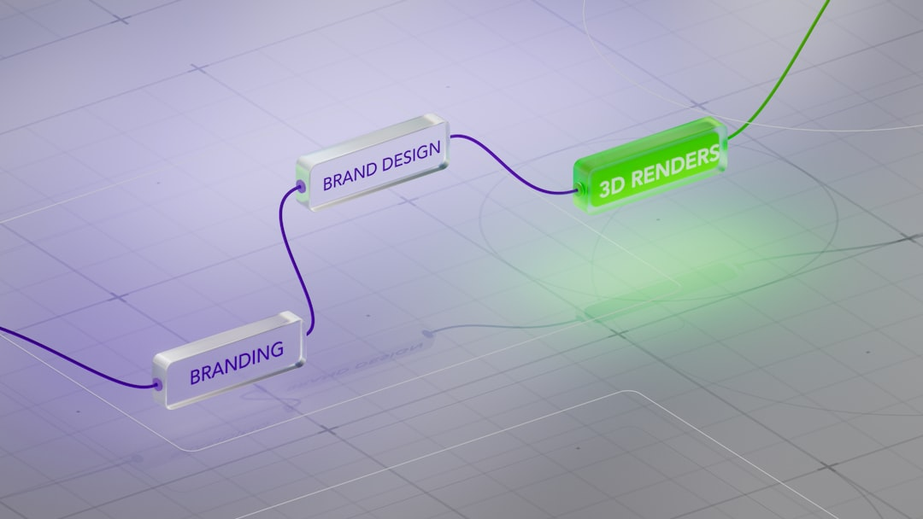
The Core Engine: Tender Lifecycle (TLE)
8-Stage Pipeline Overview
Go/No-Go Decision Control
The tender management process includes eight stages: Identified, Qualifying, Document Study, Pre-Bid, Bid Submission, Evaluation, Result, and Closed.
Integrated decision recording during the Qualifying stage ensures informed choices, enhancing the likelihood of successful bids and resource allocation.
Automated Checklists
Standardized actions at each stage, such as bid preparation and EMD arrangement, are automated to ensure compliance and efficiency in the process.
Made with SlideMaker.app

Slide 5

Technical Architecture Overview
Frontend Technologies
Backend Framework
Utilizes React.js (Vite) for dynamic UI, Material UI v5 for design consistency, and Recharts for interactive data visualization, enhancing user engagement and experience.
Powered by Node.js/Express with PostgreSQL 15, employing Sequelize for ORM, ensuring robust data integrity and efficient query handling for high-performance applications.
On-Premises Hosting
Secure deployment using Nginx and PM2, ensuring all files are stored on internal servers, eliminating cloud dependency and enhancing data security and control.
Made with SlideMaker.app

Slide 6

Future Improvements: Design & UX
Interactive Tender Calendar
Mobile-Responsive Design
A monthly view will enhance tracking of submission deadlines and pre-bid meetings, improving overall project management efficiency and accountability.
Transitioning to a fully responsive interface will allow users to access critical updates on-the-go, ensuring timely decision-making and increased productivity.
Customizable Dashboards
Users will be able to configure dashboards to prioritize KPIs relevant to their roles, enhancing focus and improving data-driven decision-making.
Made with SlideMaker.app

Slide 7
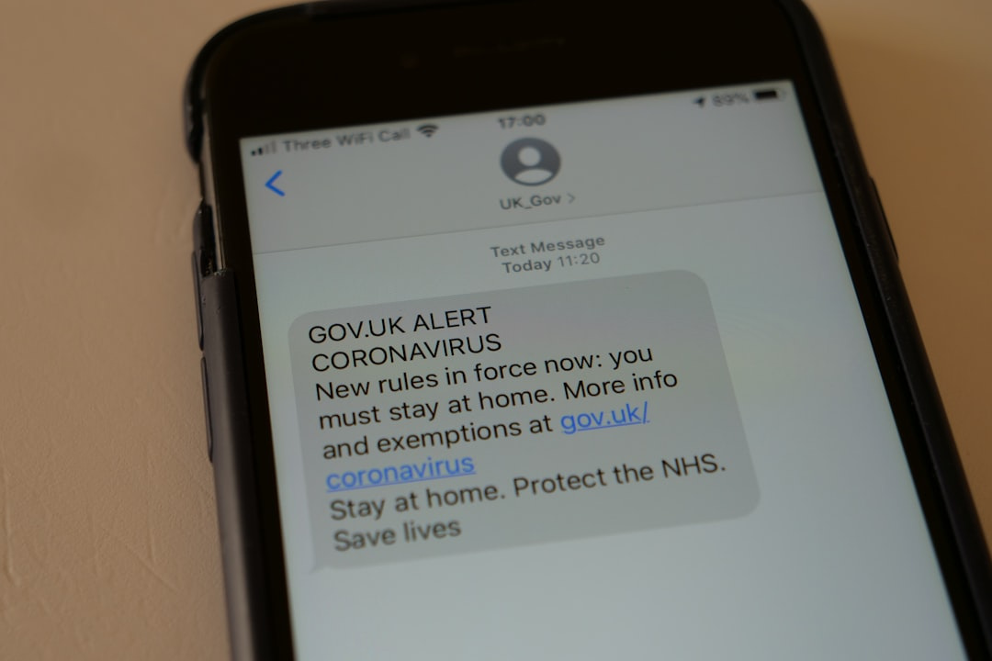
Future Improvements: System & Integration
Automated Alert Engine
Advanced Analytics (v2.0)
Implement direct email and SMS notifications for stage owners as deadlines approach, enhancing responsiveness and ensuring timely actions on critical tasks.
Introduce time-in-stage analysis to identify specific process bottlenecks, enabling targeted improvements and optimizing lead management efficiency.
Competitor Win-Rate Intelligence
Automate tracking of competitor performance in specific domains, providing strategic insights to refine bidding strategies and improve win rates.
Made with SlideMaker.app

Slide 8
Transformative Impact of LTMS
30%
25%
98%
Increase in Lead Conversion Rates
Reduction in Tender Submission Time
Order Tracking Accuracy
Achieved through enhanced tracking and analytics
Streamlined processes via automation
Improved with new systems and methodologies
40%
Boost in User Satisfaction Ratings
Post-implementation feedback from users
Made with SlideMaker.app

Slide 9
Frequently Asked Questions
Q: What types of leads can be tracked?
A: Our system allows tracking of five distinct lead types: Submitted, Domestic, Export, CRM Leads, and Lost Leads, providing comprehensive visibility into your lead management.
Q: How does the dashboard provide real-time insights?
A: The dashboard features 10 interactive charts and 6 real-time KPI cards that display critical metrics such as Win Rate %, Total Orders, and Order Value, enabling quick decision-making.
Q: What are the benefits of the automated alert system?
A: The automated alert system sends direct Email/SMS notifications to stage owners as deadlines approach, ensuring timely actions and reducing the risk of missed opportunities.
Q: How can users customize their dashboards?
A: Users can implement customizable dashboards by configuring specific widgets to prioritize different KPIs, allowing tailored views for Executives and Managers.
Made with SlideMaker.app

Slide 10
Key Takeaways
In summary, our Lead & Tender Management System has successfully implemented multi-module tracking, advanced analytics, and a structured tender lifecycle. Key next steps include enhancing CRM integration and developing a mobile-responsive design. By focusing on these improvements, we can optimize lead management and drive higher conversion rates. Let's leverage these insights to refine our strategies and ensure sustained growth in our procurement processes.
Made with SlideMaker.app

